Slide 2
The External Economic Action of the European Union and the Sustainable Development Goals
Special presentation by Klarissa Martins Sckayer Abicalam– University of Bologna- klarissa.martins2@unibo.it
University of Bologna
3 May – 25 May
25 May 2023
The Relevance of EU Trade and Investment Policy
in the Current Geopolitical Scenario

Slide 3
Outline of the module
The course’s basic coordinates
Trade law, investment law and sustainable development: basic notions
EU competences and policies in trade and investment law
Trade/investment obligations and non-trade values: the return of unilateralism
The backlash against investor-State arbitration.
The backlash against trade liberalisation
Reform proposals for the global investment and trade regimes
An overview of re-nationalisation trends in trade an investment (US, EU, UK, China)
Anti-coercion
Anti-circumvention
Retaliate against non-MPIA
Steel row, now sustainable
EU’s external economic action to raise standards abroad
Free trade agreements and non-economic standards
Conflict mineral regulation (sort of like diamonds)
2022 commitment to green trade partnership
Deforestation MERCOSUR
Zoom-in: EU dispute with Korea on labour rights
Zoom-in: level playing field and sustainable development in the Trade and Cooperation Agreement between the EU and the UK
Mirror clauses
The Carbon Border Adjustment Mechanism
Overview and assessment of the scheme
Compatibility with WTO law (China’s complaint at WTO)
Bonus: carbon removal
Energy (trade)
EU Net Zero Industry Act and support to renewable energy industry (with assessment of WTO compatibility)
Reaction to comparable foreign plans (US IRA)
Zoom-in: biofuels and e-fuels
Energy (investments)
Foreign investment protection and the fossil fuels industry
Foreign investment protection and the nuclear energy industry
Foreign investment protection and the renewable energy industry
The Energy Charter Treaty, its reform attempts and the withdrawal of EU MS
Controlling trade and investment inbound and outbound flows
Export restrictions and export controls (including coordinated action with US)
Critical Raw Materials Act
EU investment screening
Improving supply chains’ sustainability
Friend-shoring and sustainable value chains
Global supply chain due diligence proposal
EU Guidance to Combat Forced Labor in Supply Chains
Responsible forestry proposal (trade in forest-risk commodities)
WTO law-compatibility of these schemes
Promotion of other social interests
Non-paper of the Commission services 2017 TSD chatpers
Gender balance in corporate governance in FTAs
Protection of indigenous peoples’ rights
UNA Europa presentation

Slide 4
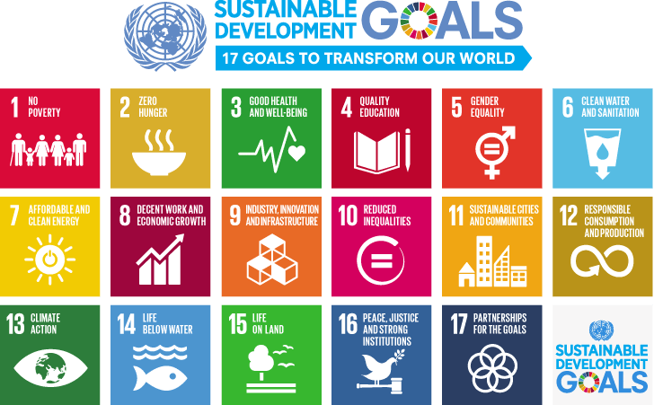

Slide 6
Philosophical basis of International Trade
Doctrine of universal economy:
Trade is socially beneficial because it fosters human interdependence, and that there is a pattern to the placement of scarce resources throughout the world which provides an incentive for trade and intercultural contact.
The Doctrine of Universal Economy and the Regulation of International Trade.” Manchester Journal of International Economic Law, vol. 17, no. 2, 2020, pp. 164–186
UNA Europa presentation

Slide 7
Philosophical basis of international trade
Trade/Peace Theory
“Commerce is the cure for the most destructive prejudices, (…)
Peace is the natural effect of trade”.
Montesquieu, Spirit of the Laws I, book. 2o, chap. i.
Trade may not always be a cause of peace, but trade and the regulation it engenders are important factors in the reduction of international conflict.”
Froese, Marc. “The Doctrine of Universal Economy and the Regulation of International Trade.” Manchester Journal of International Economic Law, vol. 17, no. 2, 2020, pp. 164–186
UNA Europa presentation

Slide 8
Philosophical basis of international trade
Trade/Peace Theory
Trade may not always be a cause of peace, but trade and the regulation it engenders are important factors in the reduction of international conflict.”
Froese, Marc.
“The Doctrine of Universal Economy and the Regulation of International Trade.” Manchester Journal of International Economic Law, vol. 17, no. 2, 2020, pp. 164–186
UNA Europa presentation

Slide 9
Philosophical basis of international trade
Trade/Peace Theory
Following the guidance of Kant’s liberal perpetual peace of 1795, the trade peace theory was consecrated in Jeremy Bentham’s Theory of the Universal and Perpetual Peace.
According to the Trade/Peace Theory, the liberal peace success depend on three conditions.
Republican Representation; How to encourage it internationally?
Commitment to human rights; Addressed through the SDGs
Transnational interdependence. which turns trade sanctions more effective
UNA Europa presentation

Slide 10
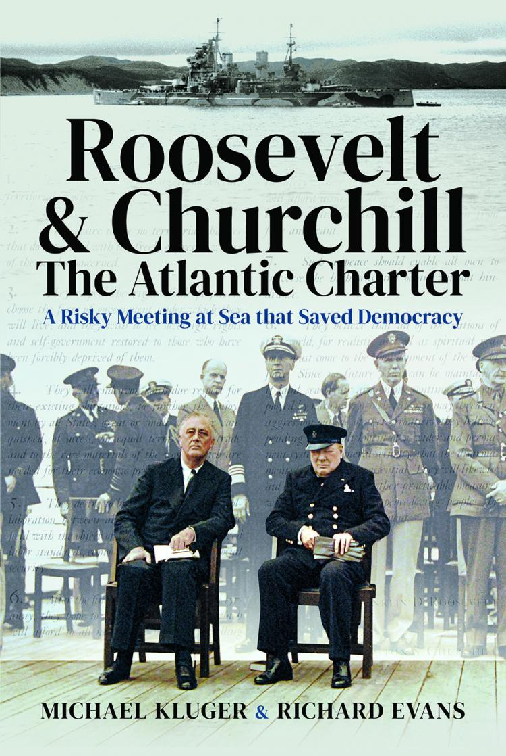
The Atlantic Charter:
In August 14 of 1941, the US and UK leaders signed the Atlantic Charter, subsequently incorporated in the Declaration of the United Nations, which included elements of the trade/peace hypothesis,
Article Four stated that the signatories would do all in their power to “further the enjoyment of all states, great or small, victor or vanquished, of access, on equal terms, to the trade and to the raw materials of the world which are needed for their economic prosperity’.
Article Seven guaranteed a post-war freedom of the seas;
and Article Eight drew a link between peace and providence, stating that “all the nations of the world, for realistic as well as spiritual reasons, must come to the abandonment of the use of force”.
Available at: https://www.nato.int/cps/en/natohq/official_texts_16912.htm

Slide 11
GATT 1947
On 1 January 1948, GATT entered into force. The 23 founding members were: Australia, Belgium, Brazil, Burma, Canada, Ceylon, Chile, China, Cuba, Czechoslovakia, France, India, Lebanon, Luxembourg, Netherlands, New Zealand, Norway, Pakistan, Southern Rhodesia, Syria, South Africa, United Kingdom and the United States.
“The making of the world order on the basis of the twin doctrines of democracy and the free market was an avowed project of the United States.”
Sornarajah, Muthucumaraswamy. The International Law on Foreign Investment. 5. ed., Cambridge University Press, 2021, p. 06.

Slide 12
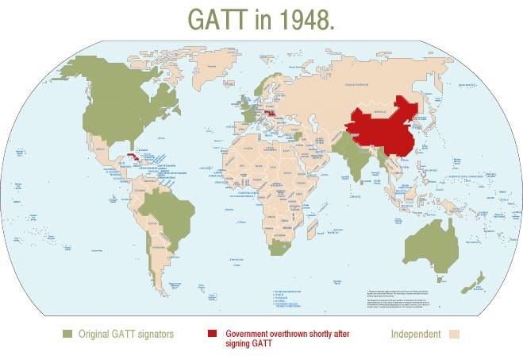

Slide 13
Creation of WTO with the Marrakesh Agreement in 1994
The negotiations that culminated with the Marrakesh Agreements took place after the fall of the Berlin Wall (1989) and the Soviet Union (1991). Until that moment, only countries allies of the capitalist western world could enjoy the benefits of free trade.
From 1995 until 2022, 36 Countries have acceded the WTO, including countries not adept of a republican form founded in democratic values and in human rights protection, as the sui generis communist China – that acceded to WTO in 2001 - and Russia – that acceded in 2012 after a long period of negotiations.

Slide 14
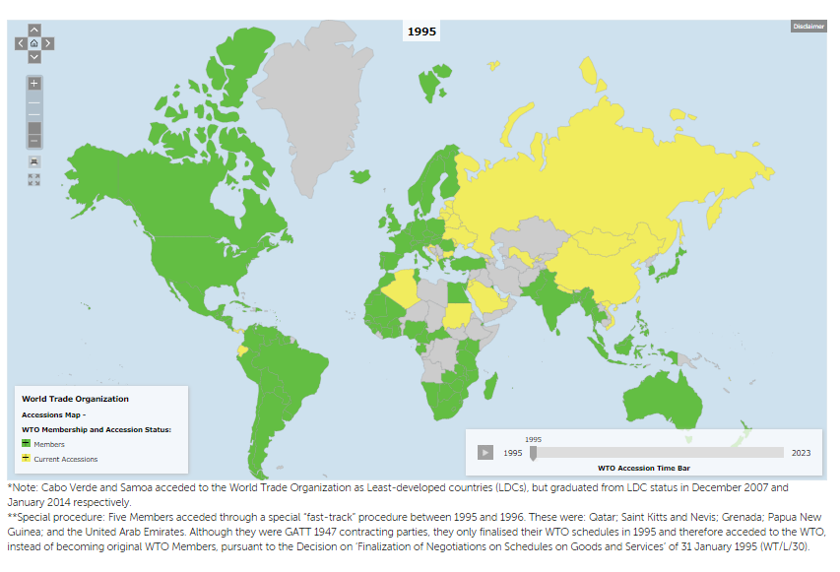

Slide 15
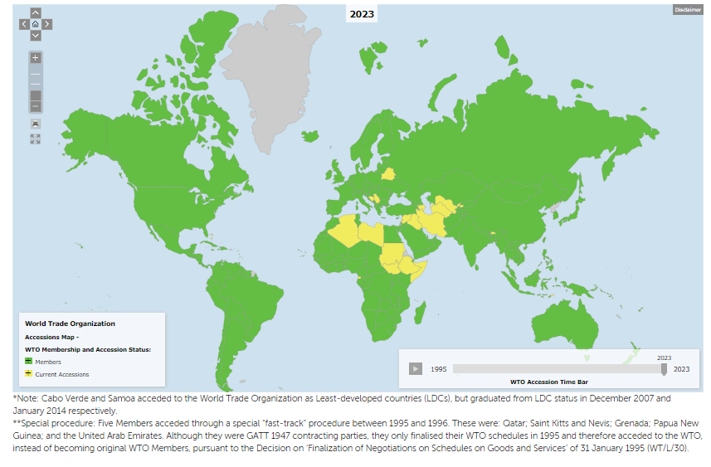

Slide 16
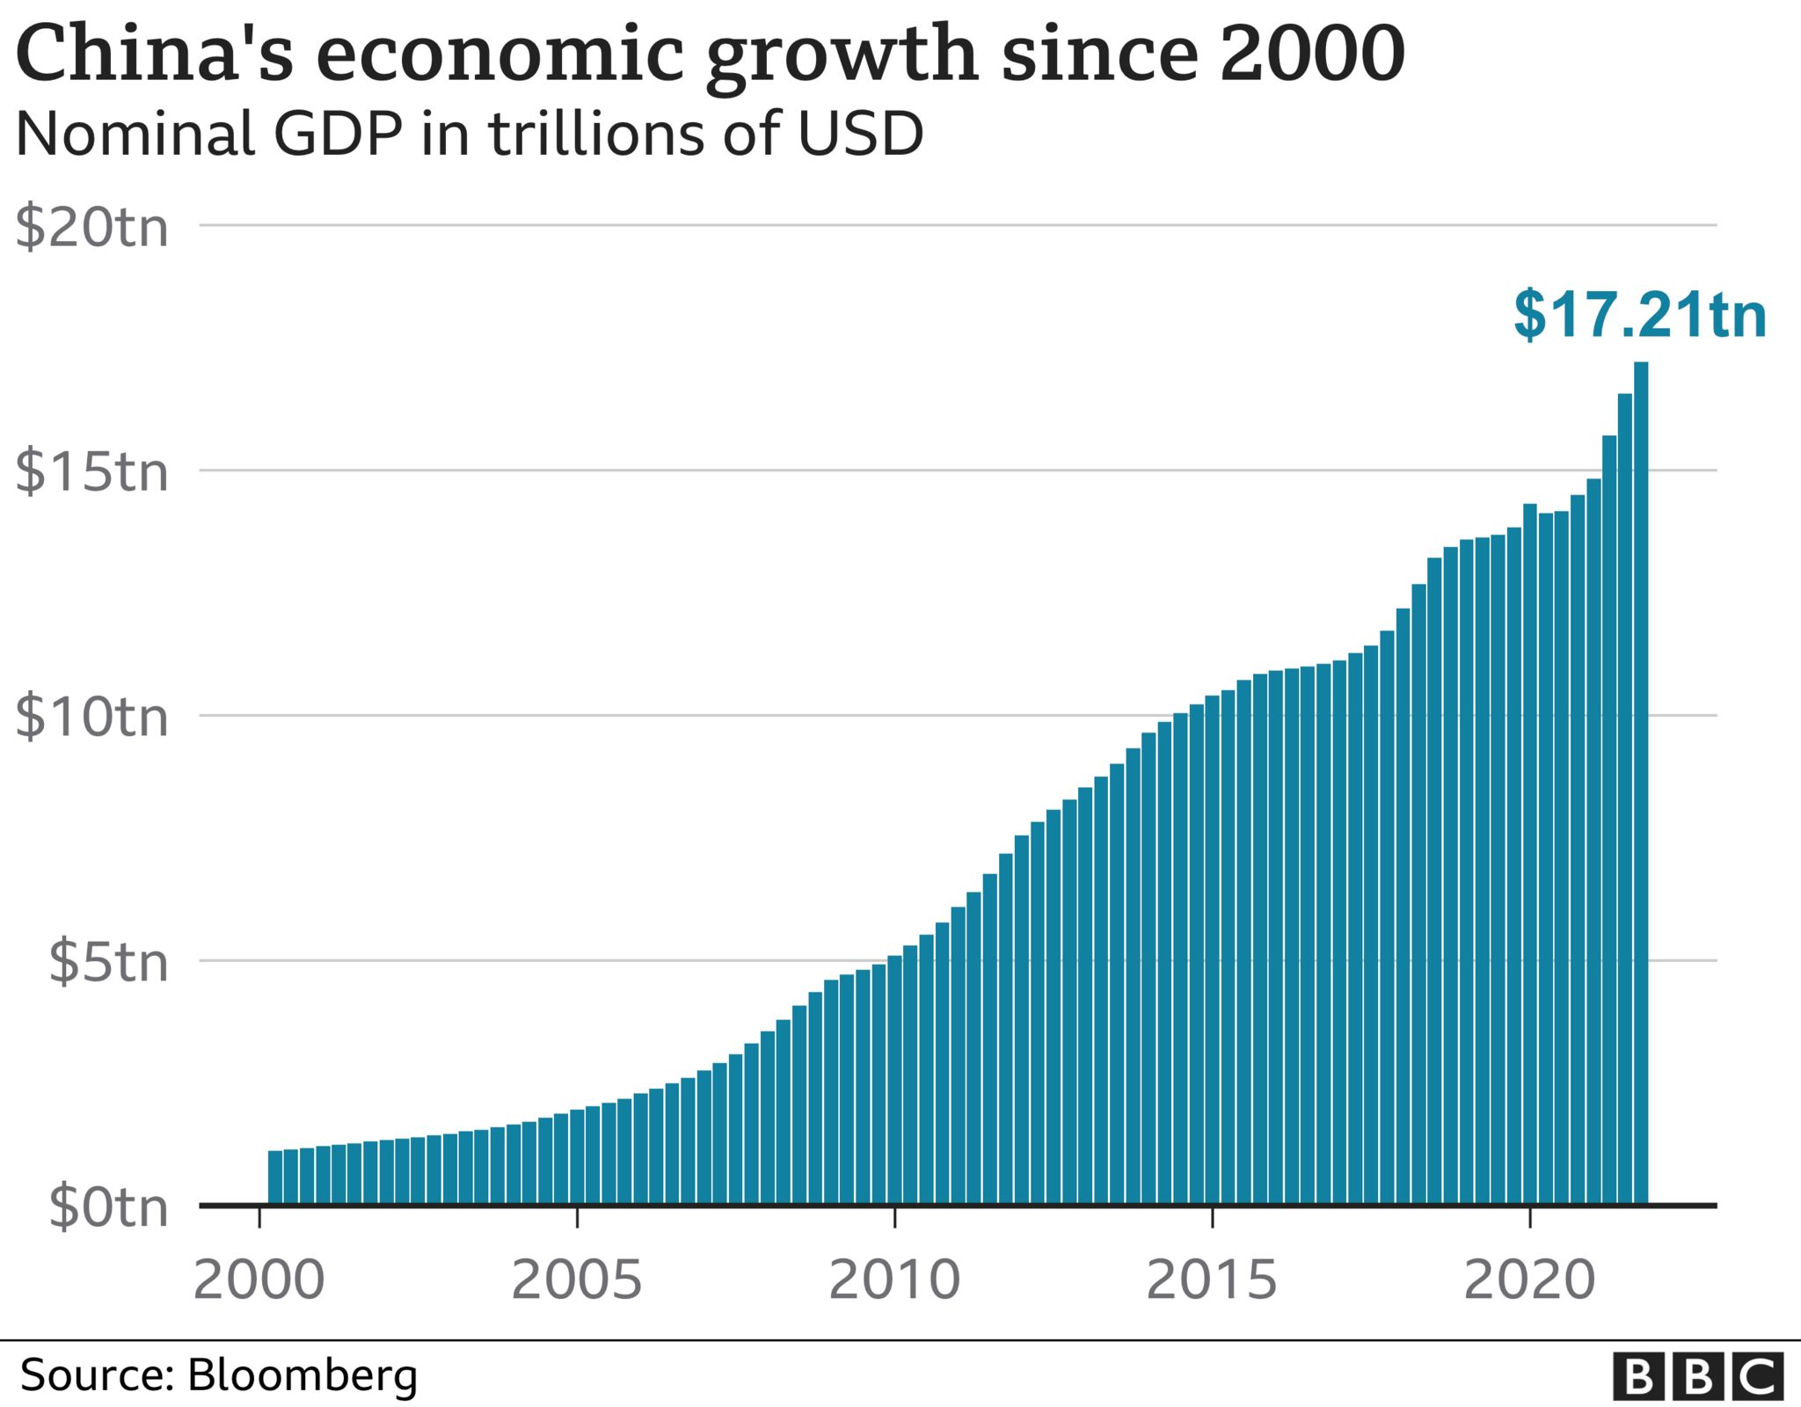

Slide 17
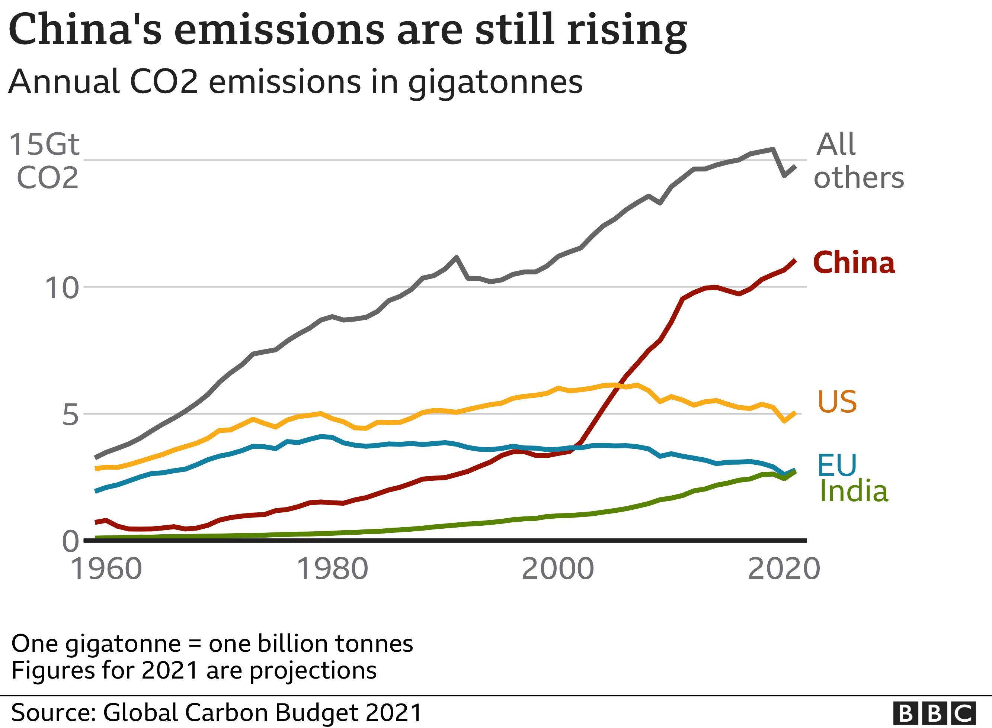

Slide 18
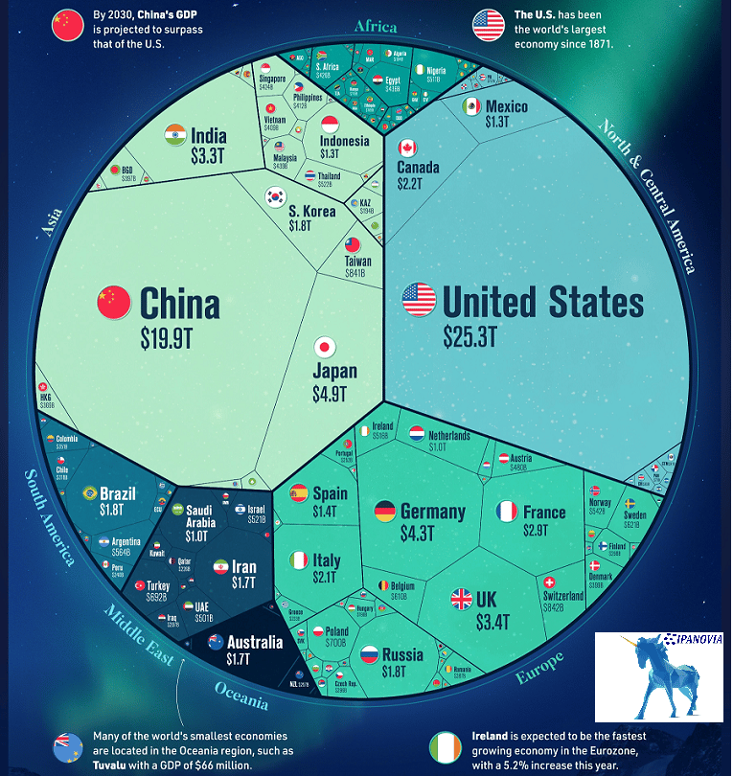
The world economy in 2022
Available at:
https://www.ipanovia.com/country-gdp/

Slide 19
As it grew economically, Washington had hoped that China would become a “responsible stakeholder” in the U.S.-led, rules-based international order. The hope was that, like South Korea and Taiwan before it, China would integrate into the global economic system, transition to a democratic form of government, and cooperate internationally through formal institutions. Unfortunately, these fond hopes were not borne out. China stubbornly resisted democratization even as its economy grew. (…) the CCP maintains complete political control in China and President Xi is the most dictatorial Chinese leader since Mao Zedong. As in other autocracies, the Chinese people lack basic political and civil liberties. They are not allowed a voice in the selection of their government. The CCP uses censorship and repression against those who dare to speak out against it. In one comical example, the party banned online images of the children’s cartoon character Winnie the Pooh when commentators noted the unflattering likeness between the rotund and pale bear and President Xi.”
Kroenig, Matthew. The Return of Great Power Rivalry: Democracy versus Autocracy from the Ancient World to the U.S. and China. New York, 2020; online edn, Oxford Academic, 19 Mar. 2020.

Slide 20
The US Proposal:
“Contrary to the myth that democracies cannot pursue long-term grand strategies, the United States has been following the same basic grand strategy for three-quarters of a century. In fact, it is a variant of the same grand strategy that liberal leviathans have been pursuing for over two thousand years from Athens to Rome, from Venice to Amsterdam, and from London to Washington, DC. Step one, build a liberal international system. Step two, invite other nations to join. Step three, defend the system from challengers. To build the system, the United States and its allies should continue to provide stability and security in important geostrategic regions. They should proceed with past designs to advance cooperation through international institutions. They should continue to champion an open economic system internationally. And they should sustain efforts to promote democracy, human rights, and good governance. Diplomatically, the United States and its allies should ensure that every country on Earth has an alternative to subjugation by Beijing or Moscow. They should not make the mistake of forcing nations to choose between Washington or their autocratic rivals. They should, however, draw attention to Russian and Chinese aggression and their atrocious human rights records and use their repulsive actions as an opportunity to expand their own alliance coalition. Every nation should understand it at least has the option of being part of the free world if it so chooses.”

Slide 21
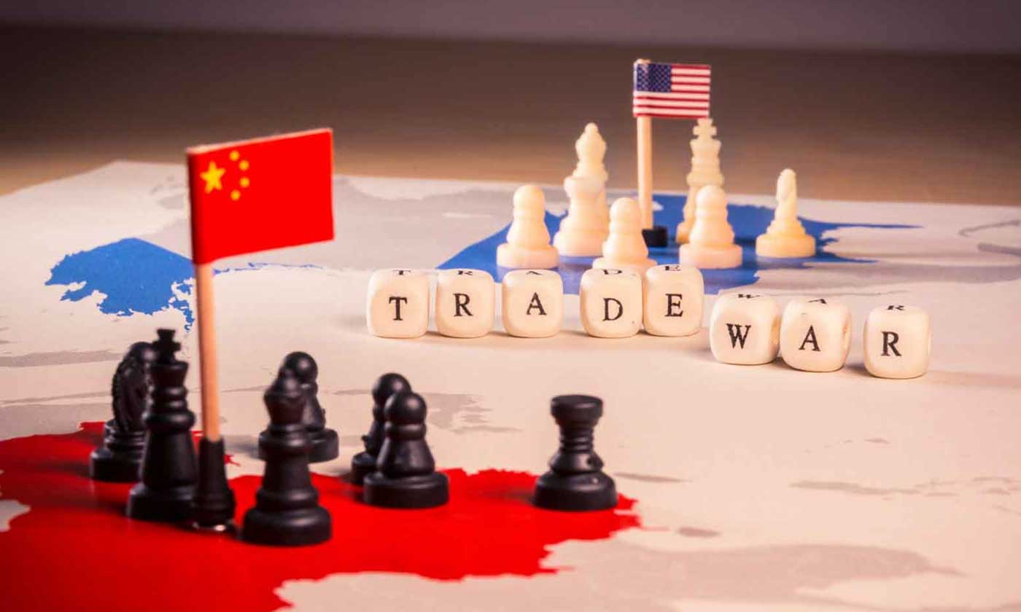

Slide 22
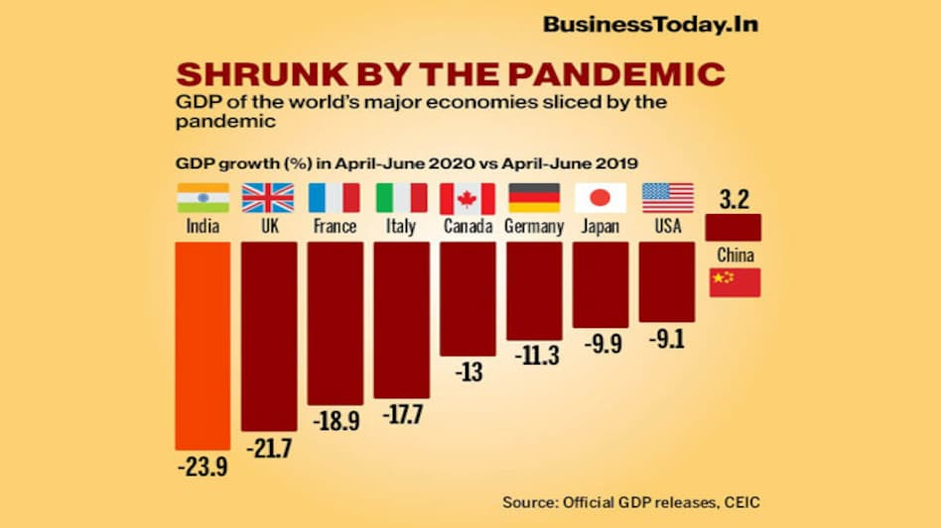

Slide 24
Trade Sanctions
NATO members and allies have imposed sanctions against Russia in response to the country's invasion of Ukraine on 24 February 2022. The sanctions include asset freezes on several Russian institutions and individuals, export restrictions and import bans and tariff escalation on Russian products such as oil, gas, steel, and iron. In addition, Russia has been stripped of its MFN treatment by EU, US and their allies.
The legal basis for the withdrawal of the MFN treatment is Article XXI of the GATT 1994 (and corresponding provisions in other WTO agreements), also known as 'security exception'. It allows WTO members to act inconsistently with WTO obligations to protect their security interests during a war or other international emergency.

Slide 25
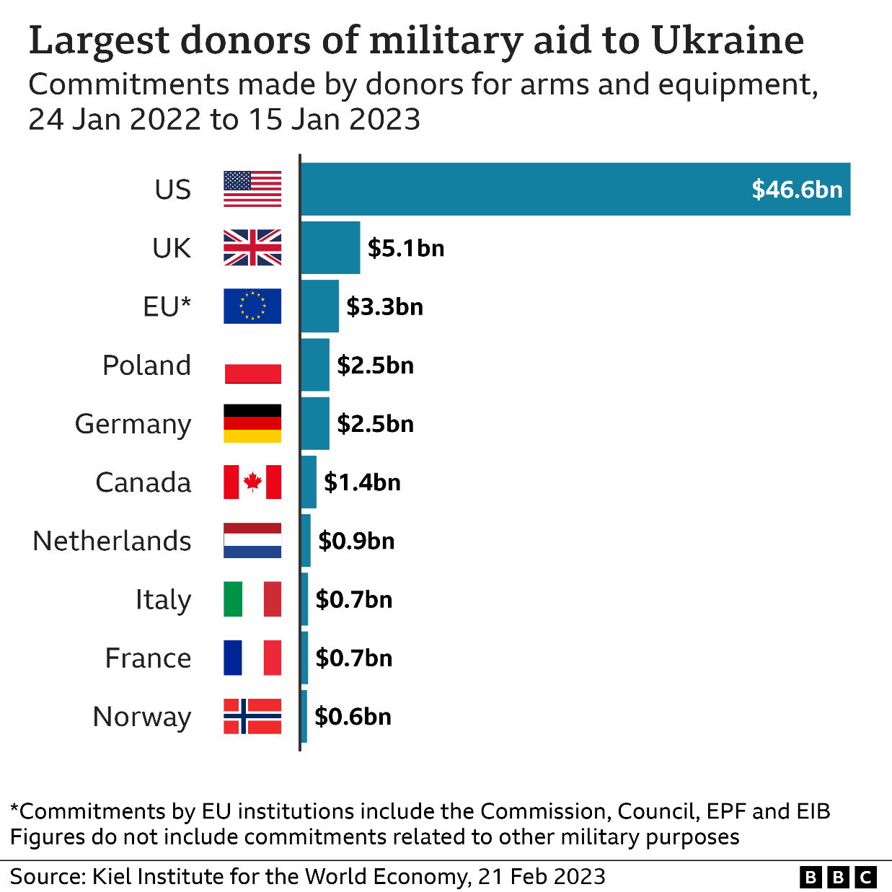

Slide 26
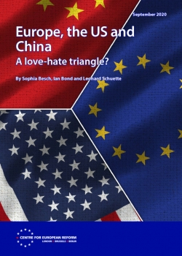
★ The EU cannot be equidistant between democratic Washington and authoritarian Beijing. Its values are bound to be closer to those of the US. But it needs to be autonomous enough to push back against ill-considered US policies.
★ Europe should not get sucked into a contest between China and the US for global hegemony. It should remain open to co-operation with China where that is in Europe’s interest. It should use its influence to ensure that both China and the US use their power with restraint. For the foreseeable future, the triangular relations between the three powers will contain elements of attraction and elements of hostility. The EU should work with Beijing and Washington to pursue pragmatic policies that maintain stability

Slide 28
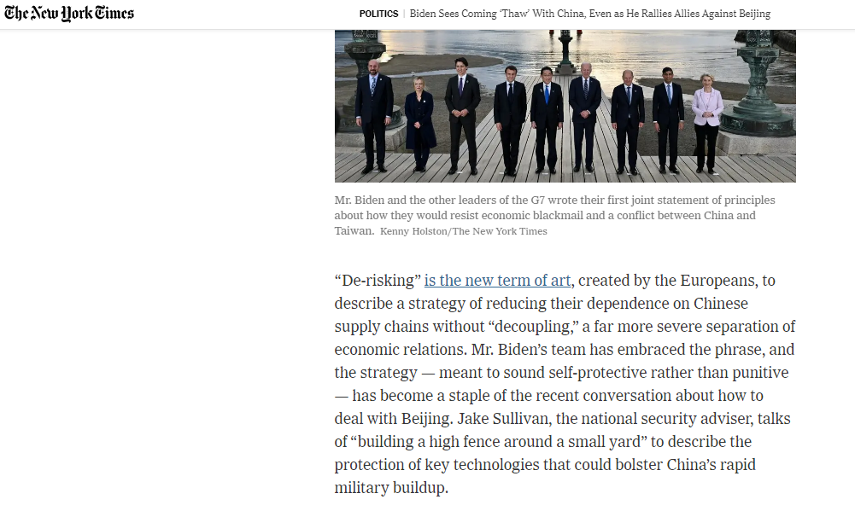

Slide 29
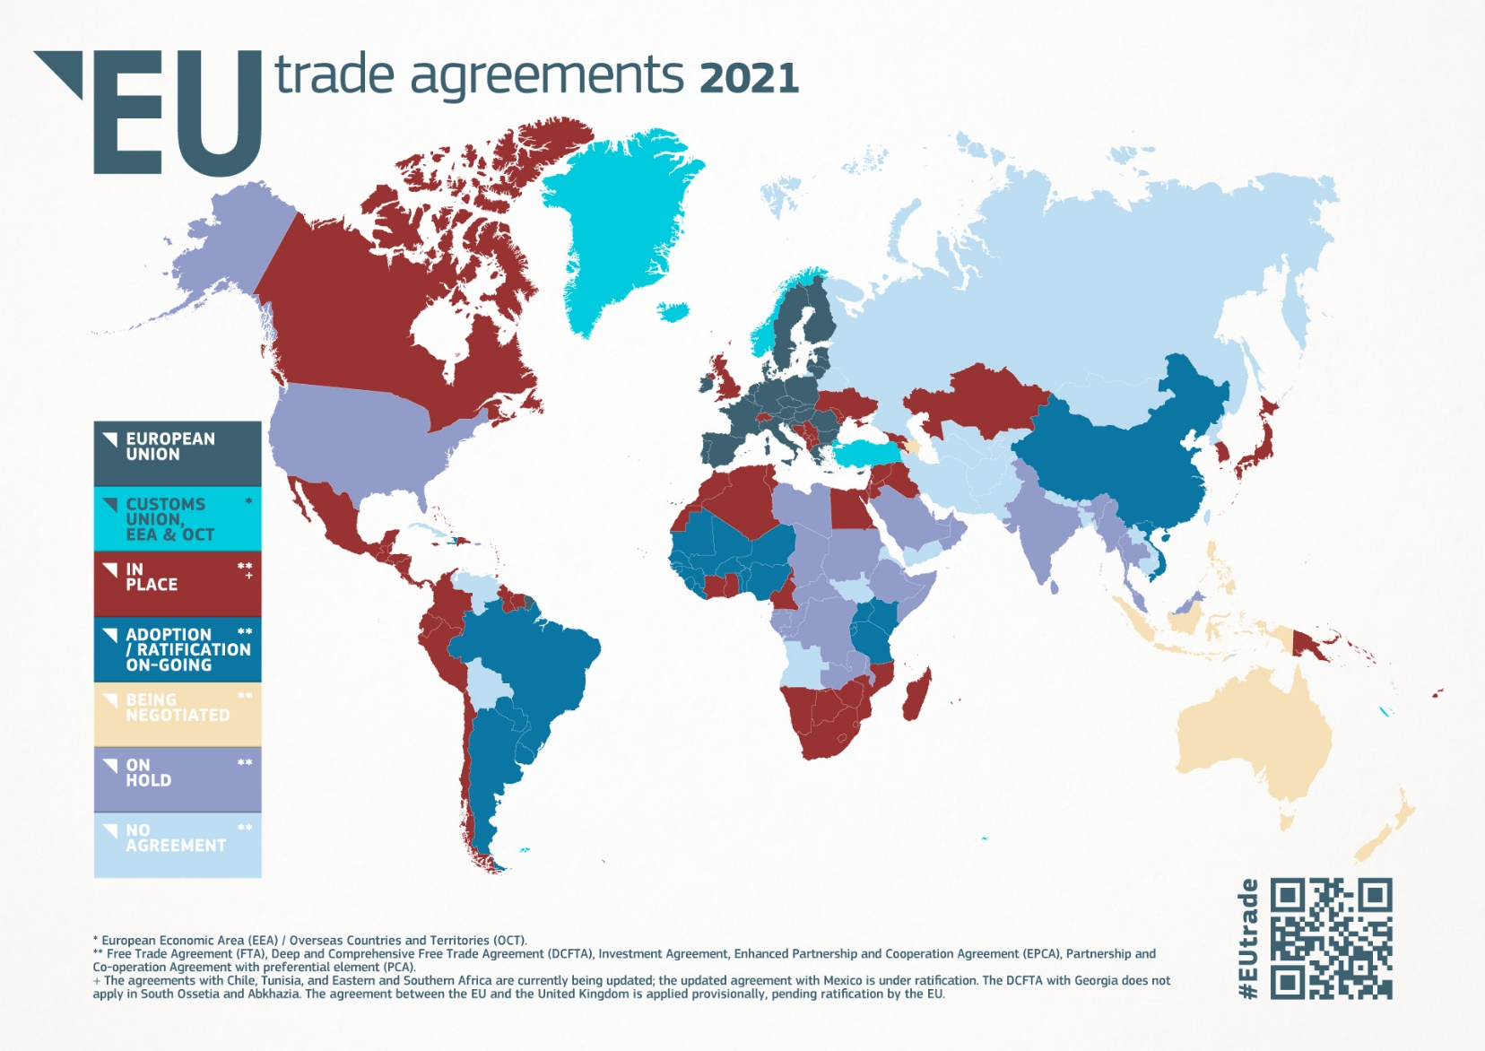

Slide 30
Our focus now is on growing the EU's broad network of trade agreements, which play a crucial role in helping our economies to grow at this time of economic uncertainty, securing privileged access to key markets for our exports, as well as access to key inputs and raw materials via diversified and resilient supply chains. Cooperation with reliable global partners matters more than ever in this changing geopolitical landscape.” Valdis Dombrovskis, the Commission's Chief Trade Enforcement Officer (CTEO) - Report on Implementation and Enforcement of EU Trade Agreements 11.10.2022.

Slide 31
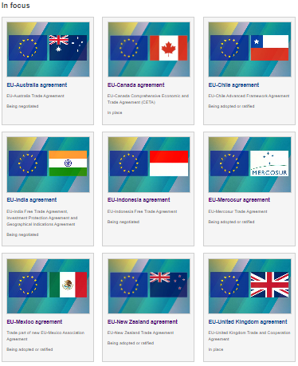
Among the FTAs, the CETA (EU-Canada) provisionaly in force since 2017 is considered a mega Mega-Regional Trade Agreement.
The EU-Mercosur is also considered Mega Regional Trade Agreement between two CUs. According to the Commision, the EU is Mercosur's second biggest trade in goods partner after China, accounting for 16.2% of the bloc's total trade in 2021.
The conclusion of FTA with India would also be paramount to guarantee EU’s influence under the BRICS and include India in EU’s value chains.

Slide 32
Mega Regional Trade Agreements can be defined as a deep interregional economic partnership between countries or regions with a major share of world trade and foreign direct investment (FDI). They have been also called region-to-region or supra-regional economic agreements. Mega Regionals can be formed between CUs and free trade areas or between one or more of them and another State that due to its large share of world trade has a similar economic relevance– if not greater- than a CUs, as is the case of Canada, US, Brazil, Russia, India and China.
The mega-regional initiatives encourage the creation of global value chains in which production is split across countries to exploit each nation’s comparative advantage, driving down costs while raising standards.

Slide 33
Mega-regionals and other trade agreements are fundamentally changing the landscape of the world trading system, in a number of ways. Not only do they create specialized trade regimes, they also establish regulatory frameworks that are less about free trade and more about standardization. They include investment, services, intellectual property and other provisions in domains that the WTO has also tried to expand. Panezi, Maria. The WTO and the Spaghetti Bowl of Trade Agreements: Four Proposals for Moving Forwards. Centre for International Governance Innovation (CIGI), Policy Brief No. 87, September 2016. Available at https://www.cigionline.org/sites/default/files/pb_no.87.pdf

Slide 35
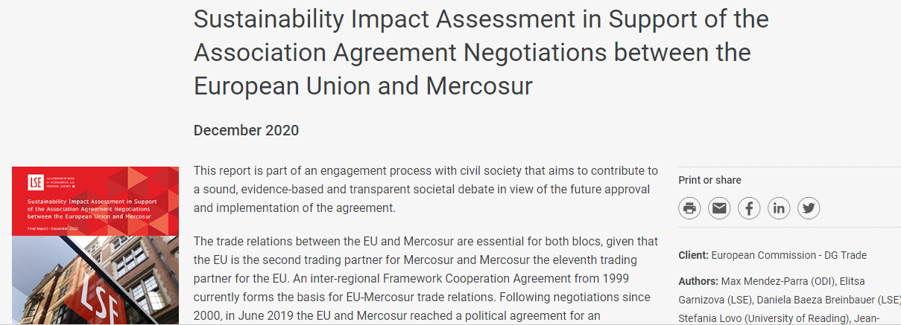

Slide 36
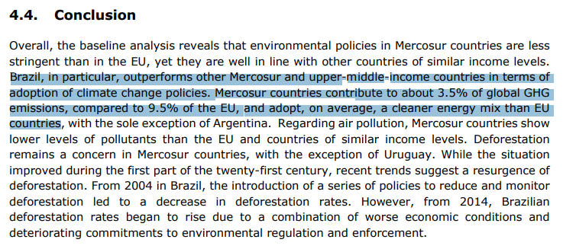

Slide 37
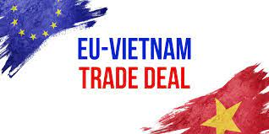
The European Union and Vietnam signed a Trade Agreement and an Investment Protection Agreement on 30 June 2019. The European Parliament gave its consent to both Agreements on 12 February 2020 and the Free Trade Agreement was concluded by EU Member States in the Council on 30 March 2020. The Trade Agreement entered into force on 1 August 2020.

Slide 38
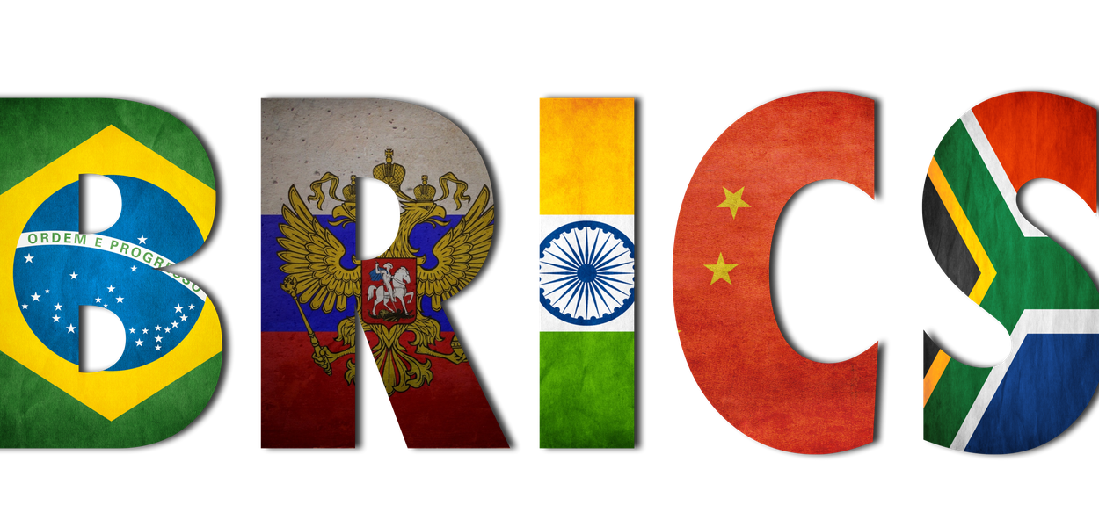

Slide 39
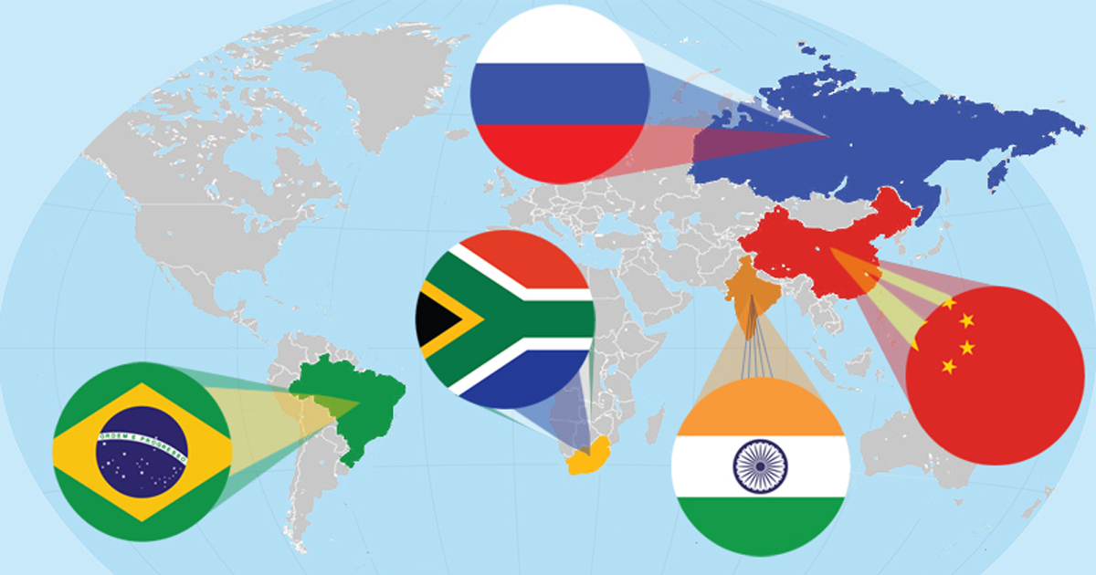
Is iunder way a new global order ruled by the BRICS?

Slide 43
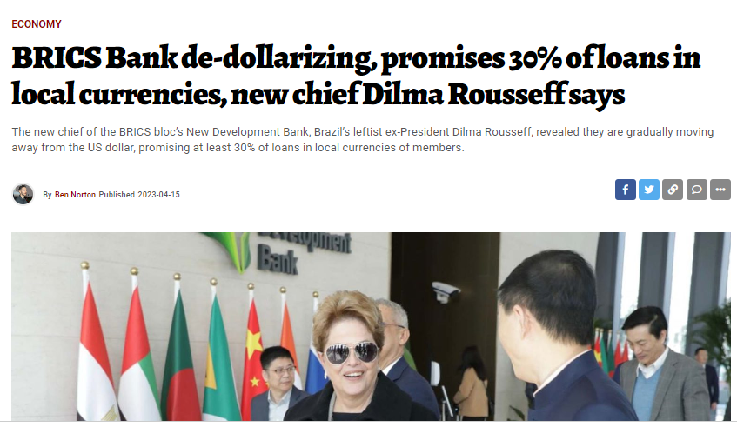

Slide 45
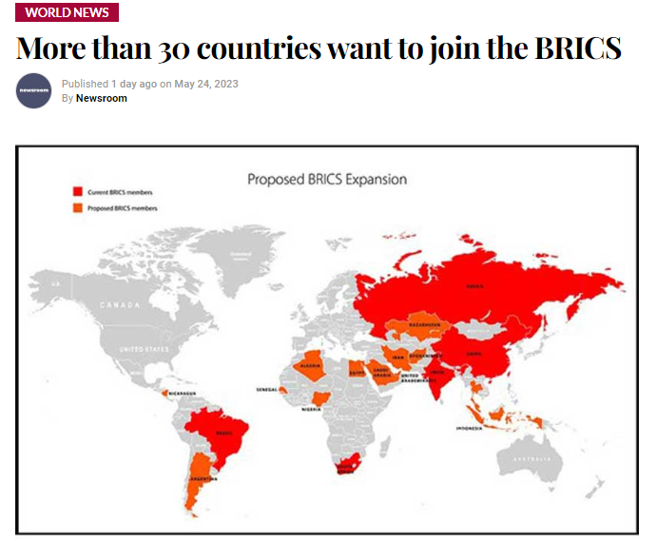

Slide 47
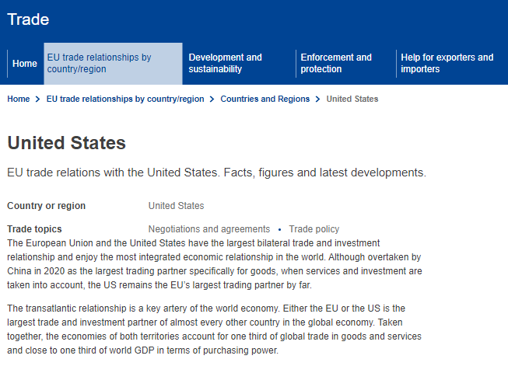

Slide 48
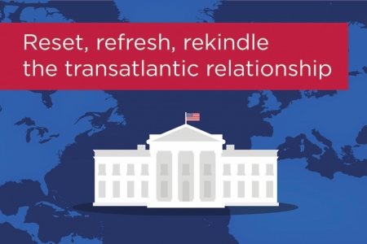

Slide 49
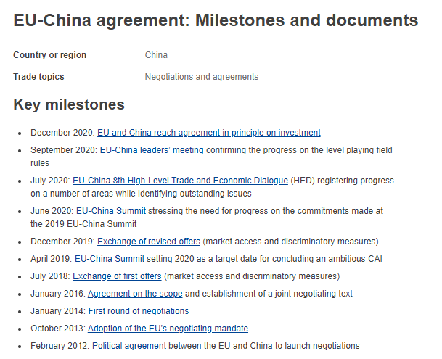

Slide 50
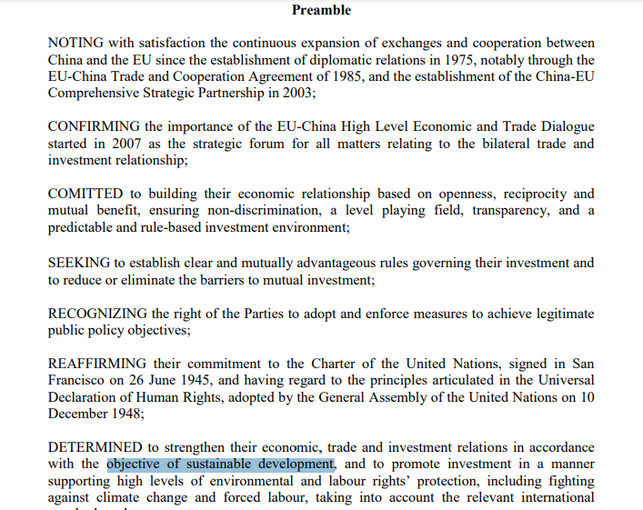

Slide 51
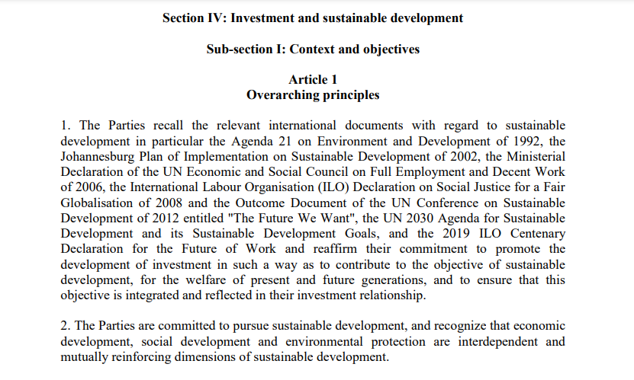

Slide 52
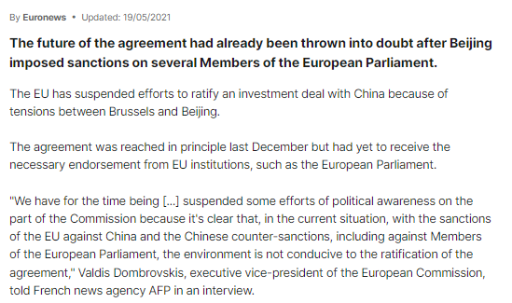

Slide 53
What could be the way?
“For the foreseeable future, the three big economic and political powers in the world will be China, the EU and the US, and the triangular relations between them will contain elements of attraction and elements of hostility. Western firms will still want to tap the Chinese market, while governments worry about threats to national security; Chinese families will still want their children to study in the West, while the Communist Party worries about the ideological contamination they might bring back; and Europe and the US will still be each other’s most important security and economic partners, while bickering about defence budgets and food safety. In the absence of a friction-free utopia, the EU’s best option is to work with Beijing and Washington to pursue pragmatic policies that maintain stable relations between the three.” Europe, the US and China: A Love-Hate Triangle?, Centre for European Reform, Sep. 2020, p. 22.

Slide 54
Enforcement of TSD Provisions in EU Trade and Investment Agreements:
In summary there are three different approaches: a cooperative one, that encourages the parties to solve any dispute arising from the gender provisions through diplomatic means; a sanction-based one under which the matter is solved through binding adjudication of a panel of experts or arbitral tribunal; and a mixed procedure that firstly attempt to amicably solve the matter through State-to State consultations, and whether consultations fail, the question is submitted to a panel of experts which issues recommendations to be followed by the parties through their best efforts but without being backed by any sanction in case of non-compliance.

Slide 55
EU-New Zealand TSD Chapter
The TSD Committee is entitled to monitor the implementation of the compliance measures, and the imposition of trade sanctions are only allowed in cases of non-compliance with a Report that concluded for the violation of a core multilateral labour standards or for an action or omission that materially defeats the object and purpose of the Paris Agreement. Article 26.3 (b) EU-New Zealand FTA. The TSD Committee is also competent to inform the domestic advisory groups established under Article 24.6, and the contact point of the other Party, of communications and opinions received from the public.
Article 26.16 (2), EU-New Zealand FTA.

Slide 56
Conditions to ImprovEUorGlobe: Dialogue, Pragmatical Cooperation and Coherency in Trade and Investment Policies

Slide 57
@una_europa #Una_Europa
Thank you very much!
klarissa.martins2@unibo.it

